Slide 1
Chapter 01
Java Introduction 6 .

Slide 2
Chap 01
Introduction of Java
Introduction to Java
Java Syntax
Java Output / Print
Double Quotes
Java Output Numbers
Java Comments
Java Variables
Types of Variables……

Slide 3
What is Java?
Java is a popular programming language, created in 1995.
It is owned by Oracle, and more than 3 billion devices run Java.
It is used for:
  Mobile applications (especially Android apps)
  Desktop applications
  Web applications
  Web servers and application servers
  Games
  Database connection
  And much, much more!

Slide 4
What is Java?
Why Use Java?
  Java works on different platforms (Windows, Mac, Linux, Raspberry Pi, etc.)
  It is one of the most popular programming languages in the world
  It has a large demand in the current job market
  It is easy to learn and simple to use
  It is open-source and free
  It is secure, fast, and powerful.

Slide 5
Java Syntax
Note: Java is case-sensitive: "MyClass" and "myclass" have different meanings.
we created a Java file called Main.java, and we used the following code to print "Hello World" to the screen:
Explanation:
public class Main
  This creates a class called Main.
  In Java, every program must be inside a class.
public static void main(String[] args)
  This is the main method. is a group of statements, calculations, and instructions or Commands.
  It is the starting point of every Java program.
  When you run the program, Java looks for this method first.
System.out.println("Hello World");
  This prints text on the screen.
  System.out.println means “show something on the screen and go to a new line.”
  Here, it shows Hello World.
public class Main {
public static void main(String[] args) {
System.out.println("Hello World");
}
}

Slide 6
Java Output / Print
Print Text
the previous slide that you can use the println() method to output values or print text in Java.
You can add as many println() methods as you want.
Note that it will add a new line for each method.
Example
public class Main {
public static void main(String[] args) {
System.out.println("Welcome to java");
  System.out.println("Hello World!");
  System.out.println("I am learning Java.");
  System.out.println("It is awesome!");
}
}

Slide 7
Double Quotes
Text must be wrapped inside double quotation marks "".
If you forget the double quotes, an error occurs.
  System.out.println("This sentence will work!");
The Print() Method
There is also a print() method, which is similar to println().
The only difference is that it does not insert a new line at the end of the output.
  System.out.println("Hello World! "); ------> inserting new line.
  System.out.print("I will print on the same line."); ---------> adding two lines

Slide 8
Java Output Numbers
Print Numbers
  You can also use the println() method to print numbers.
  However, unlike text, we don't put numbers inside double quotes.
public class Main {
public static void main(String[] args) {
System.out.println(3 + 3);
  System.out.println(3);
  System.out.println(358);
  System.out.println(50000);
}
}

Slide 9
Java Comments
Comments can be used to explain Java code, and to make it more readable. It can also be used to prevent execution when testing alternative code or Transilation.
Single-line Comments
Single-line comments start with two forward slashes (//).
Any text between // and the end of the line is ignored by Java (will not be executed).
public class Main {
public static void main(String[] args) {
// This is a comment
System.out.println("Hello World");
}
}

Slide 10
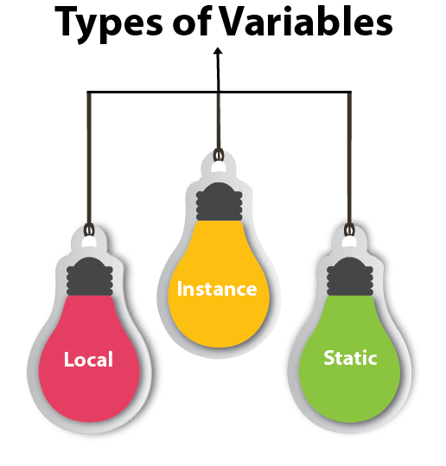
Java Variables
A variable is a container that holds a value while the Java program is executed. A variable is assigned a data type.
A variable is the name of a memory location. There are three types of variables in Java: local, instance and static.
Variable
A variable is the name of a reserved area allocated in memory. In other words, it is the name of the memory location.
Types of Variables
There are three types of variables in Java:
  local variable
  instance variable
  static variable

Slide 11
1) Local Variable
A variable declared inside the body of the method is called a local variable. You can use this variable only within that method.
A local variable cannot be defined with the "static" keyword.
2) Instance Variable
A variable declared inside the class but outside the body of the method, is called an instance variable. It is not declared as static.

Slide 12
3) Static variable
A variable that is declared as static is called a static variable. It cannot be local.
You cannot declare it inside a method (it cannot be local).
Only one copy of a static variable is created.

Slide 13
Java Variables
Variables are containers for storing data values.
  String - stores text, such as "Hello". String values are surrounded by double quotes
  Int - stores integers (whole numbers), without decimals, such as 123 or -123
  Float - stores floating point numbers, with decimals, such as 19.99 or -19.99
  Char - stores single characters, such as ‘a or B'. Char values are surrounded by single quotes.
  Boolean - stores values with two states: true or false.
Declaring (Creating) Variables
To create a variable in Java, you need to:
  Choose a type (like int or String)
  Give the variable a name (like x, age, or name)
  Optionally assign it a value using =
Syntax
type variableName = value;

Slide 14
Examples
1. Create a variable called name of type String and assign it the value "John".
Then we use println() to print the name variable:-
2. Create a variable called myNum of type int and assign it the value 15:
public class Main {
public static void main(String[] args) {
String name = "John";
System.out.println(name);
}
}
Out put
John
public class Main {
public static void main(String[] args) {
int myNum = 15;
System.out.println(myNum);
}
}
Out put
15

Slide 15
Cont.…
3. You can also declare a variable without assigning the value, and assign the value later:
Out put
public class Main {
public static void main(String[] args) {
int myNum;
myNum = 15;
System.out.println(myNum);
}
}
15

Slide 16
Java Print Variables
Display Variables
The println() method is often used to display variables.
To combine both text and a variable, use the + character:
You can also use the + character to add a variable to another variable:
Output
public class Main {
public static void main(String[] args) {
String name = "John";
System.out.println("Hello " + name);
}
}
Hello John
public class Main {
public static void main(String[] args) {
String firstName = "John ";
String lastName = "Doe";
String fullName = firstName + lastName;
System.out.println(fullName);
}
}
Output
John Doe

Slide 17
Cont.…..
For numeric values, the + character works as a mathematical operator (notice that we use int (integer) variables here):-
public class Main {
public static void main(String[] args) {
int x = 5;
int y = 6;
System.out.println(x + y); // Print the value of x + y
}
}
Out put
11

Slide 18
Java Declare Multiple Variables
Declare Many Variables
To declare more than one variable of the same type, you can use a comma-separated list:
One Value to Multiple Variables
You can also assign the same value to multiple variables in one line:
public class Main {
public static void main(String[] args) {
int x = 5, y = 6, z = 50;
System.out.println(x + y + z);
}
}
Out put
61
public class Main {
public static void main(String[] args) {
int x, y, z;
x = y = z = 50;
System.out.println(x + y + z);
}
}
Out put
150

Slide 19
Next Chapter 02
Variables and Comments.

